Slide 1
Telecom Churn Prediction

Slide 2
Introduction
Churn Prediction is one of the most big data use cases in business.
It consists of detecting customers who are likely to cancel subscription to a service.
Churn is a problem for telecom companies because it is more expensive to acquire a new customer than to keep your existing one from leaving.

Slide 3
Project Objective
To predict Customer Churn.
Highlighting the main variables / factors influencing the Customer Churn .
Data Analytics approach to build a robust churn strategy.
Methodology of building a churn model.
Outcomes and deliverables.

Slide 4
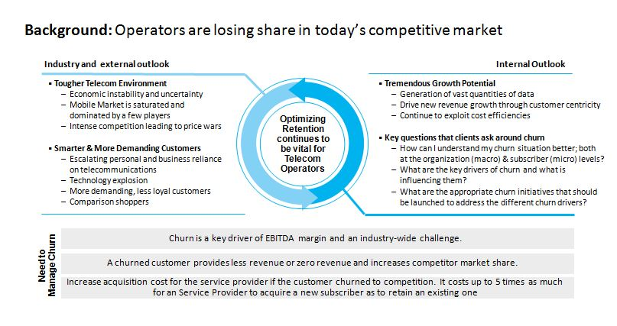

Slide 5
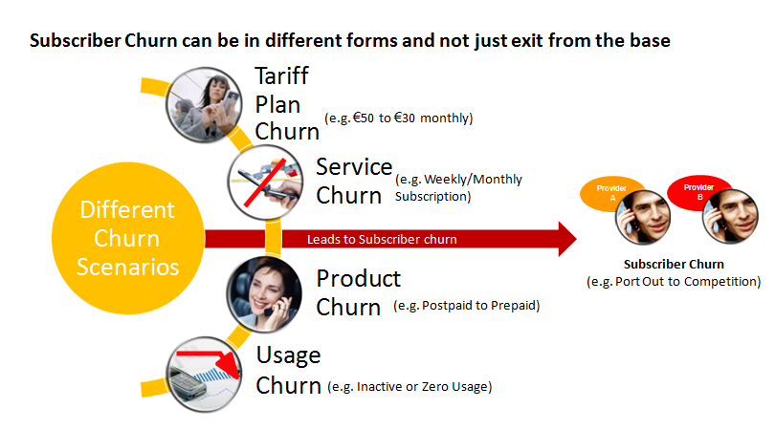

Slide 6
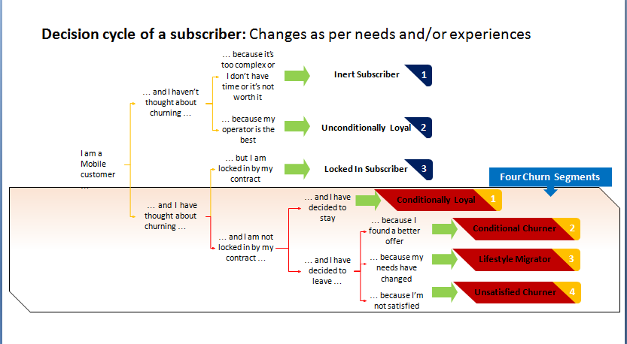

Slide 7
Data set Description
Source data set is in csv format.
Data set contains 7043 rows and 21 columns.
There is no missing values for provided input data set.
Churn is a target variable which notifies whether a particular customer churned or not.

Slide 8
Exploratory Data Analysis
EDA is an approach to analyse data sets and summarize their main characteristics ,often with visual methods.
Data visualisation using seaborn and matplotlib.
The data set consists 21 variables. Few are numerical, rest are categorical values
For categorical values we will do
Univariate Analysis
Bivariate Analysis
Multivariate Analysis.
For numerical values we will do
Correlation matrix
Kernel distribution estimation

Slide 9
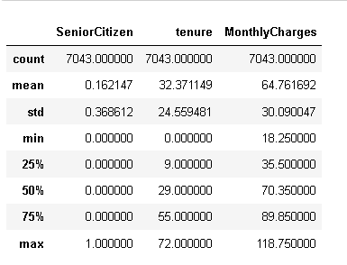
Descriptive statistics of numeric variables
Senior Citizen is actually a categorical hence the 25%-50%-75% distribution is not proper.
75% customers have tenure less than 55 months.
Average Monthly charges are USD 64.76 whereas 75% customers pay more than USD 89.85 per month

Slide 10
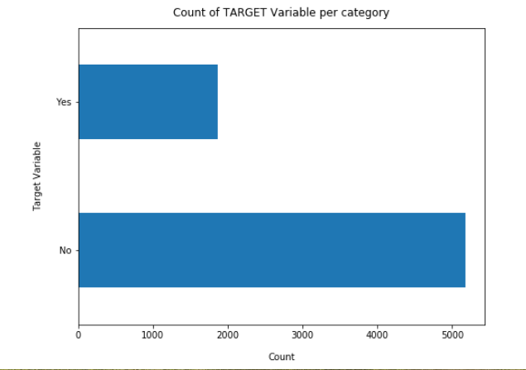
Bar Graph
The plot shows a class imbalance of the data between churners and non-churners.
Non Churners = 5174
churners = 1869
ratio = 73:27 and the churners = 1869
So we analyse the data with other features while taking the target values separately to get some insights.

Slide 11
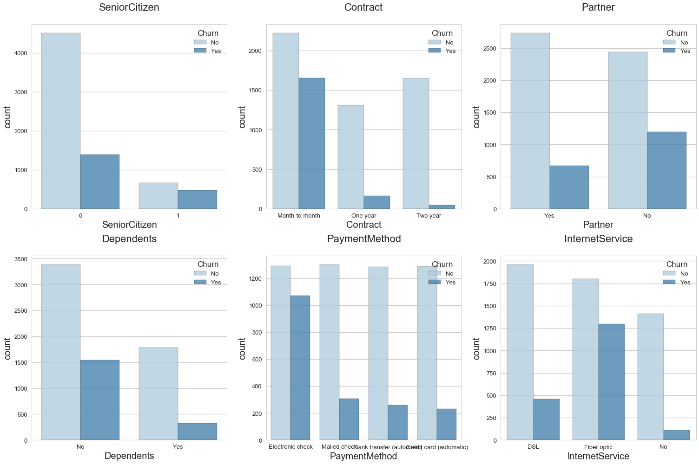
BOX PLOT
Churning customers have much lower tenure with a median of ca. 10 months compared to a median of non-churners of ca. 38 months.
Churning customers have higher monthly charges with a median of ca. 80 USD and much lower inter quartile range compared to that of non-churners (median of ca. 65 USD).
Total Charges are the result of tenure and Monthly Charges, which are more insightful on an individual basis.

Slide 12
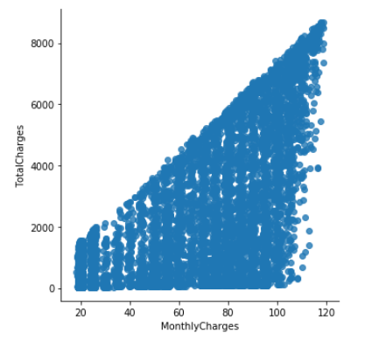
Relationship between Monthly Charges and Total Charges
Total Charges increase as Monthly Charges increase - as expected.

Slide 13
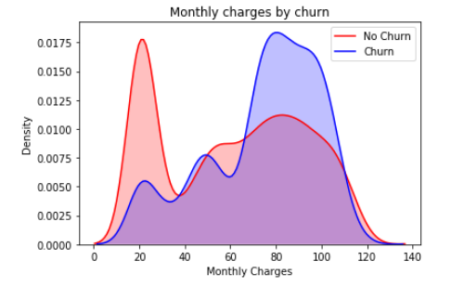
Churn by Monthly Charges
Churn is high when Monthly Charges are high

Slide 14
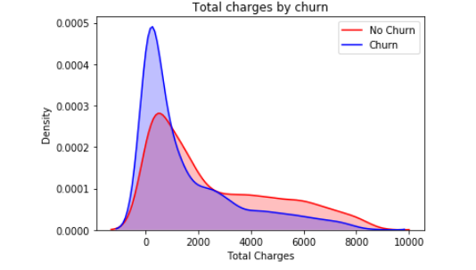
Churn by Total Charges
As higher Churn at lower Total Charges.
However if we combine the insights of 3 parameters i.e. Tenure, Monthly Charges & Total Charges then the picture is bit clear :- Higher Monthly Charge at lower tenure results into lower Total Charge.
Hence, all these 3 factors viz Higher Monthly Charge, Lower tenure and Lower Total Charge are linked to High Churn.

Slide 15
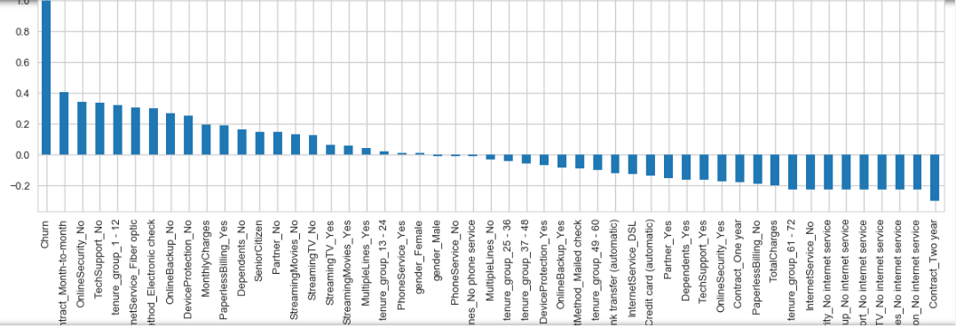
Correlation of all predictors with ‘Churn’
HIGH Churn seen in case of Month to month contracts, No online security, No Tech support, First year of subscription and Fibre Optics Internet
LOW Churn is seen in case of Long term contracts, Subscriptions without internet service and The customers engaged for 5+ years
Factors like Gender, Availability of Phone Service and # of multiple lines have almost NO impact on Churn

Slide 16
How to reduce Customer Churn
Be proactive with communication.
Define a roadmap for your new customers.
Offer incentives
Ask for feedback often.
Analyse churn when it happens.
Stay competitive

Slide 17
CONCLUSION
Electronic check medium are the highest churners
Contract Type - Monthly customers are more likely to churn because of no contract terms, as they are free to go customers.
No Online security, No Tech Support category are high churners
Non senior Citizens are high churners

Slide 18
The importance of this type of research in the telecom market is to help companies make more profit.
It has become known that predicting churn is one of the most important sources of income to Telecom companies.
Hence ,this research aimed to build a system that predicts the churn of customers of telecom company.

Slide 19
Thank You

